Slide 1
Dynamics 365 Online
Examples

Slide 2
Examples
Plugin.
Workflow.
REST Web API.

Slide 3
Plugin
Validate fields.
Change field values.
Pass and receive parameter from form to plugin.
Get data from dynamics 365 REST web api and redirect page.

Slide 4
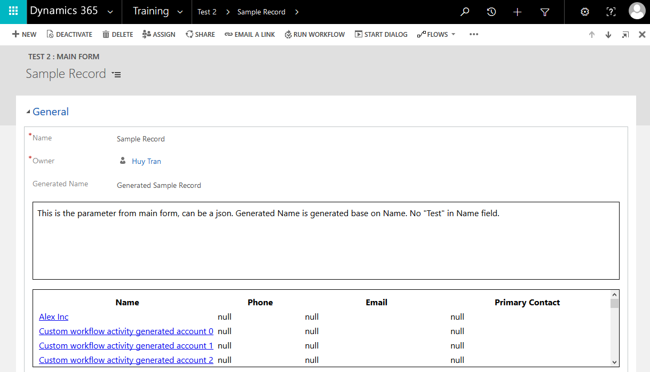
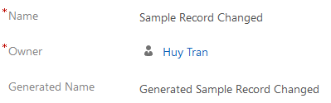
Validate
Update “Generated Name” on “Name” field value changes
Parameter from main form
Data from Dynamics 365 REST web api.
Click to redirect to edit form.

Slide 5
Workflow
Scheduled workflow with given time.
Custom workflow for creating accounts.
Pass and receive parameter in custom workflow.

Slide 6
Scheduled Workflow
Run workflow
Perform main action
Wait
Start this workflow

Slide 7

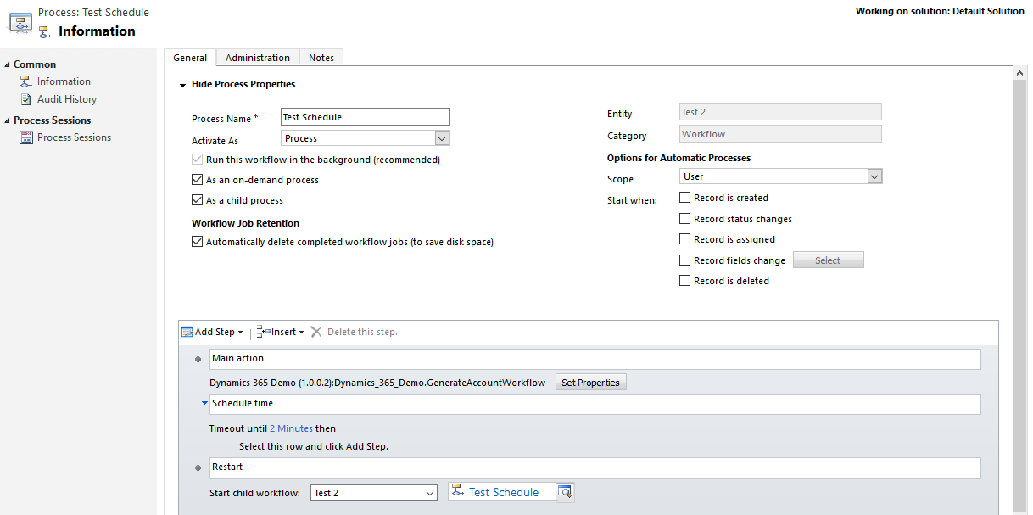
Scheduled Workflow

Slide 8
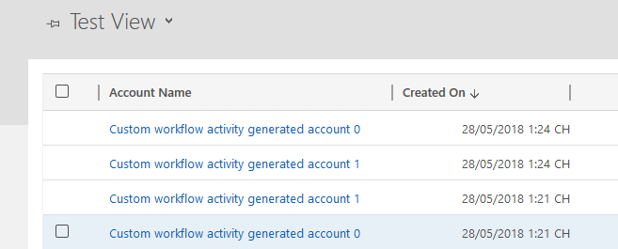
Scheduled Workflow
Result:

Slide 9
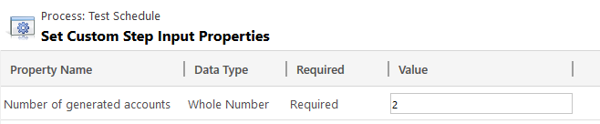
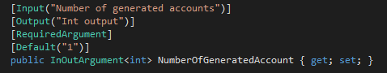
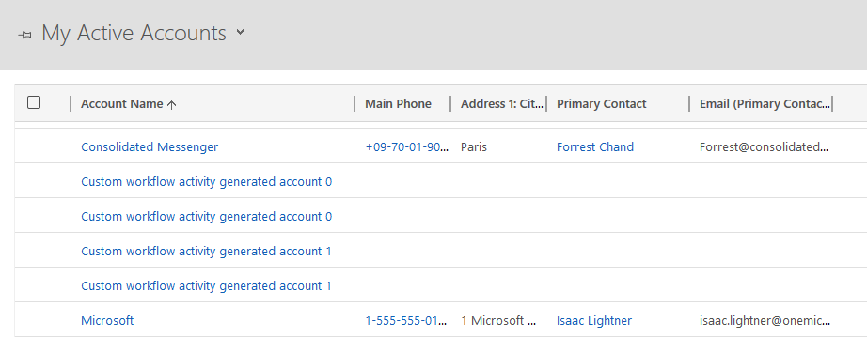
Custom Workflow for Creating Account
Pass parameter to workflow:
In custom workflow:
Result:
First run: 2 accounts created
Second run: 2 accounts created

Slide 10
Auto Number Generator Plugin
Objective: to generate a string based on settings (prefix, max, min).
Example: prefix = “GT”, max=10, min=4.
First record: GT004.
Second record: GT005.
Last record: GT010.

Slide 11
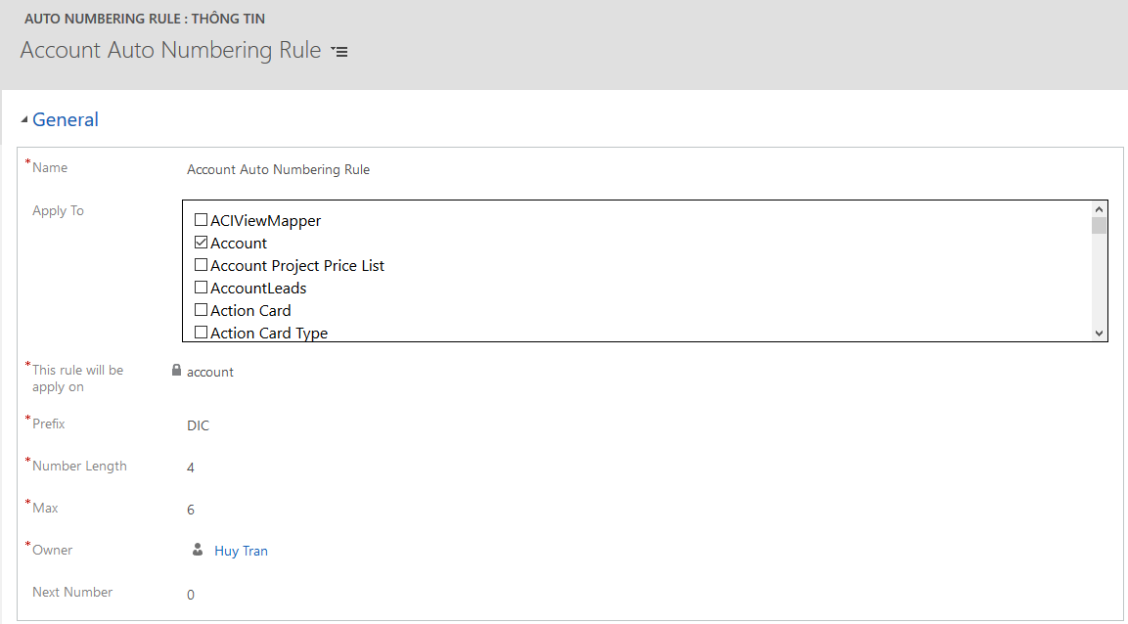
Auto Number Generator Plugin
Create a custom entity to store settings.
Web resource:
Html, javascript ajax, web api.

Slide 12
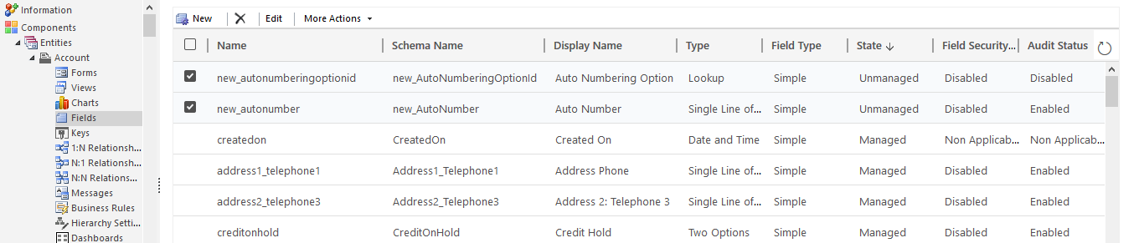
Auto Number Generator Plugin
Add 2 columns to entity:
new_autonumberingoptionid: lookup to setting entity.
new_autonumber: to store generated string.

Slide 13
Auto Number Generator Plugin
Register a plugin on Create and Update on any entity.
Plugin details:
Check if user updates setting entity(rule).
If user removes rule on current record, clear “Auto Number” of current record.
Check if the rule is applying to current record.
Check if “Next Number” reaches “Max”.
Generate string and increase “Next Number” on rule.

Slide 14
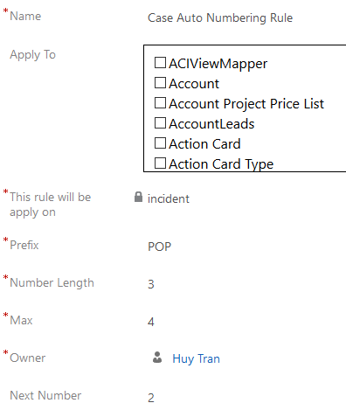
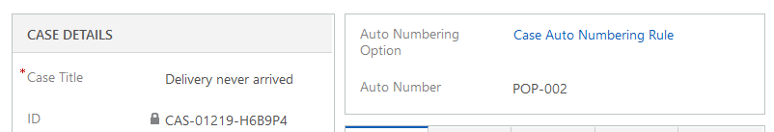
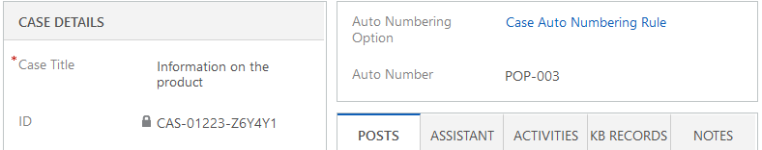
Auto Number Generator Plugin Result
Rule: Record 1:
Record 2:

Slide 15
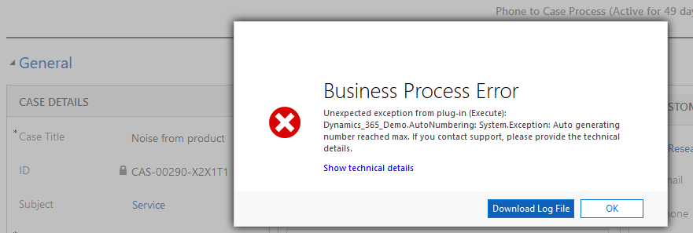

Auto Number Generator Plugin Result
Record 3:
Record 3 with account rule:

Slide 16
REST Web API
SPA.
Call Dynamics 365 web api from ASP.NET.

